Slide 1
Radio lesson #1 - Principles
CI Jadon Tsai

Slide 2
Housekeeping
Photo ID
Lunch
Test
Rewrites

Slide 3
Background
ROC-A required to use aeronautical mobile frequencies (mostly 118.000 MHz to 136.975 MHz)
Administered by Innovation, Science, and Economic Development Canada (formerly Industry Canada)
https://ised-isde.canada.ca/site/professional-radio-operator-certificate-services/en
https://ised-isde.canada.ca/site/spectrum-management-telecommunications/sites/default/files/attachments/2022/ric21-upd-oct-2011.pdf

Slide 4
Officially (you don’t need to know this):
An ROC-A is required by operators of radiotelephone equipment on board aircraft and at aeronautical land (fixed and mobile) radio stations using aeronautical mobile frequencies. The radiotelephone equipment at such stations shall be of a type that requires only simple external switching, has a power output not exceeding 250 watts effective radiated power (e.r.p.) – equivalent to 400 watts peak envelope power (PEP) – and where all frequency-determining elements are preset within the transceive

Slide 5
How do radios work?
Aviation radios are AM
3D (kind of), but we will consider 2D
Hertz = 1/second
Line of sight
VHF vs HF (noise)
Bandwidth (5G issues)

Slide 6
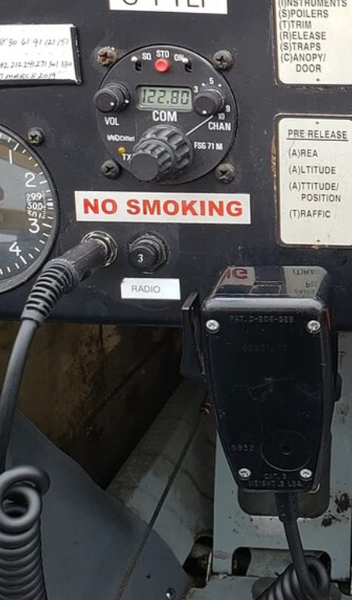
Example

Slide 7
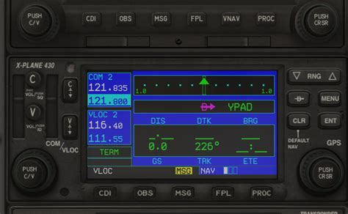
Example #2

Slide 8
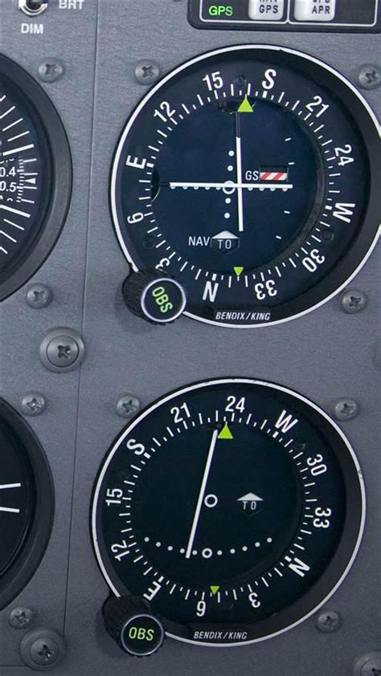
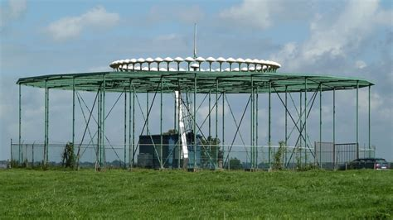
VLOC? DME? VOR?

Slide 9
Radio lesson #2 - Regulations

Slide 10
Priority of communications
Distress
Urgency
Radio direction finding
Flight safety messages
Meteorological messages
Flight regularity messages
Messages relating to the application of the United Nations Charter
Government messages for which priority has been expressly requested
Service communications relating to the workings of the telecommunication service or to communications previously exchanged
All other aeronautical communications.

Slide 11
Privacy of communications
All communications are private
EXCEPT:
If given permission
To the government/court
To forward the message
Distress/urgency/ALL STATIONS
Fine of $25 000 and/or 1 year jail time
$75 000 for a corporation

Slide 12
Superfluous communication
Generally professional environment
Cannot interfere (unless higher priority)
False distress signals
$5 000 and/or 1 year jail time
$25 000 for a corporation

Slide 13
Word match!

Slide 14
Call signs
Air to ground: ground station has control (generally aircraft initiates)
Air to air: station being called has control
Side note: call signs assigned by ISED for ground stations, based on letters for aircraft (assigned by Transport Canada)

Slide 15
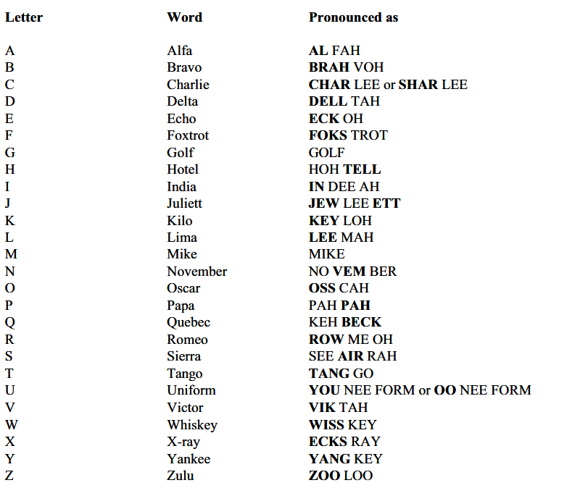
Alphabet

Slide 16
Radio lesson #2 - Procedures

Slide 17
Numbers
GMT/UTC/Zulu
If one time zone, can use local time
24 hour time, just say 4 numbers
If date, just say 6 numbers (DDTTTT)
Digits except “thousand”
“Decimal”, “dollar”, same order as writing
Headings/field elevation, say that word first (also assumed magnetic in SDA)
Type numbers, cloud heights, are in group (ten, sixty, etc.)

Slide 18
More numbers
0: zero
1: wun
2: too
3: tree
4: fower
5: fife
6: six
7: seven
8: ait
9: niner
Decimal: Dayseemal
Thousand: Tousand

Slide 19
Procedures
Before calling, wait and listen (unless you’re distress, urgency, safety)
Call sign of person being called
“This is”
Your call sign
The frequency you’re on
There exist ALL STATION and multiple station calls (rare)
Reply with the same, but either go ahead or standby
If you don’t know if it’s for you, wait
If you don’t know who called, ask (station calling)
Can abbreviate callsigns on subsequent messages
“Correction”

Slide 20
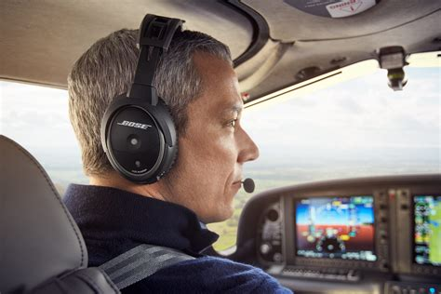
How to talk
Not to fast or too slow (the person may have to write down what you’re saying)
You probably have to eat the mic

Slide 21
Radio checks
Bad
Poor
Fair
Good
Excellent
Not more than 10 seconds

Slide 22
Listening time!
https://www.liveatc.net/

Slide 23
Activity!

Slide 24
Alphabet

Slide 25
Not good situations
Distress: A condition of being threatened by grave and/or imminent danger and requiring immediate assistance.
Urgency: A condition concerning the safety of an aircraft or other vehicle, or of someone on board or within sight, but which does not require immediate assistance.
Try your frequency first, then move to 121.5 MHz (your ELT broadcasts there and 406 MHz)

Slide 26
Distress
Initially: Mayday x3, your callsign x3 (does not need acknowledgement)
Then:
“Mayday”
Your callsign
Your issue and intentions
Where you are
People on board
Other info
Your callsign

Slide 27
Cont’d
Need to repeat until someone acknowledges it, can get relayed (remember line of sight?)
“Seelonce mayday” until cancelled

Slide 28
Urgency
Has to be addressed to someone or everyone
PAN PAN
If not all stations, can continue talking

Slide 29
Activity!
(again)

Slide 30
Alphabet

Slide 31
Test

